Slide 1


Green must be convenient
Roberto Freato Azure MVP / Author / CTO @Retex

Slide 2


Join at slido.com #1037166
ⓘ Start presenting to display the joining instructions on this slide.

Slide 3
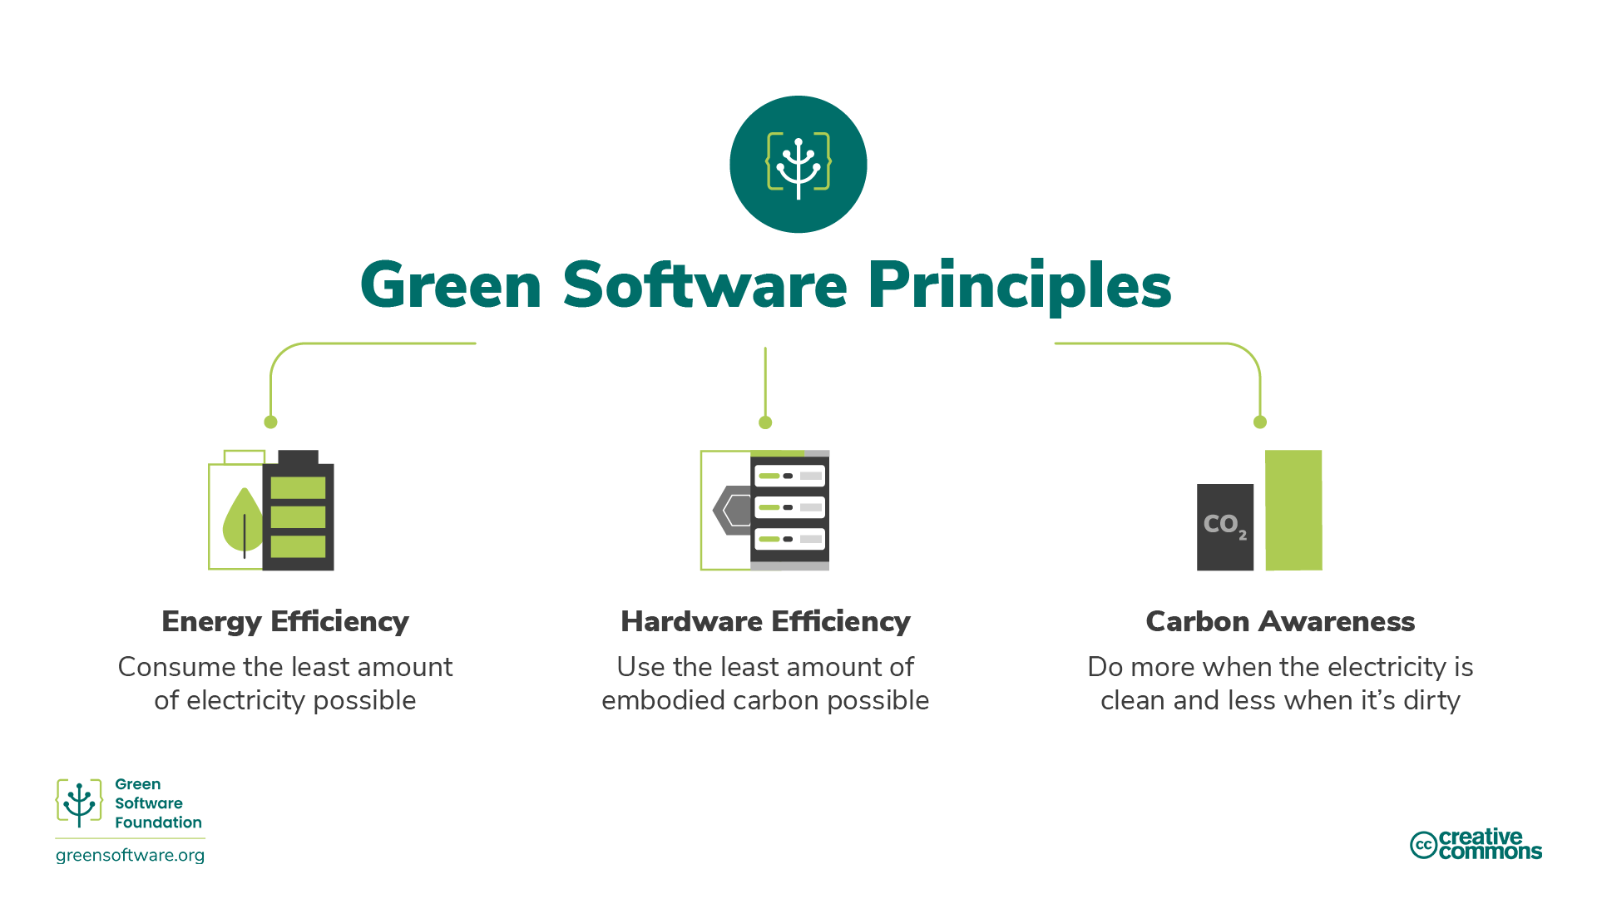

Slide 4
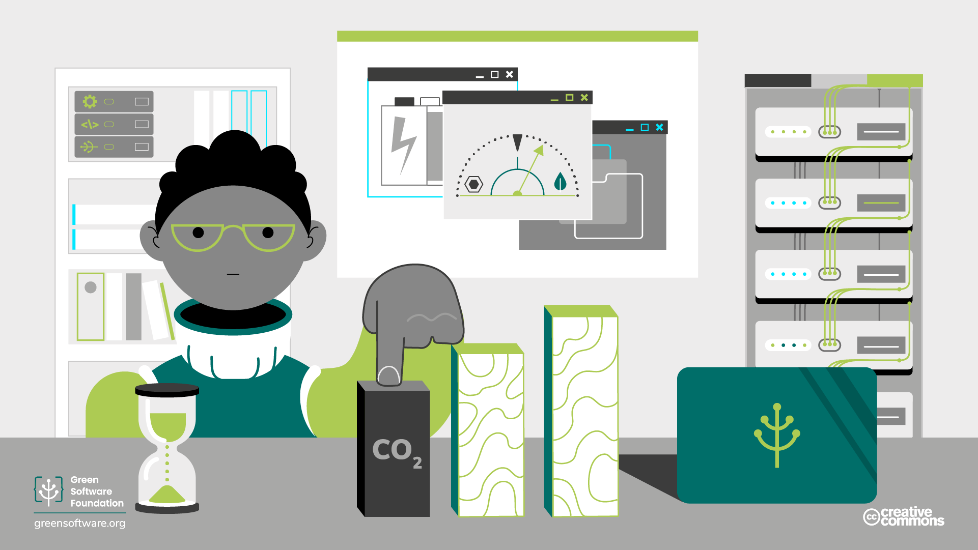
Carbon and CO2eq

Slide 5
Energy Efficiency

Slide 6
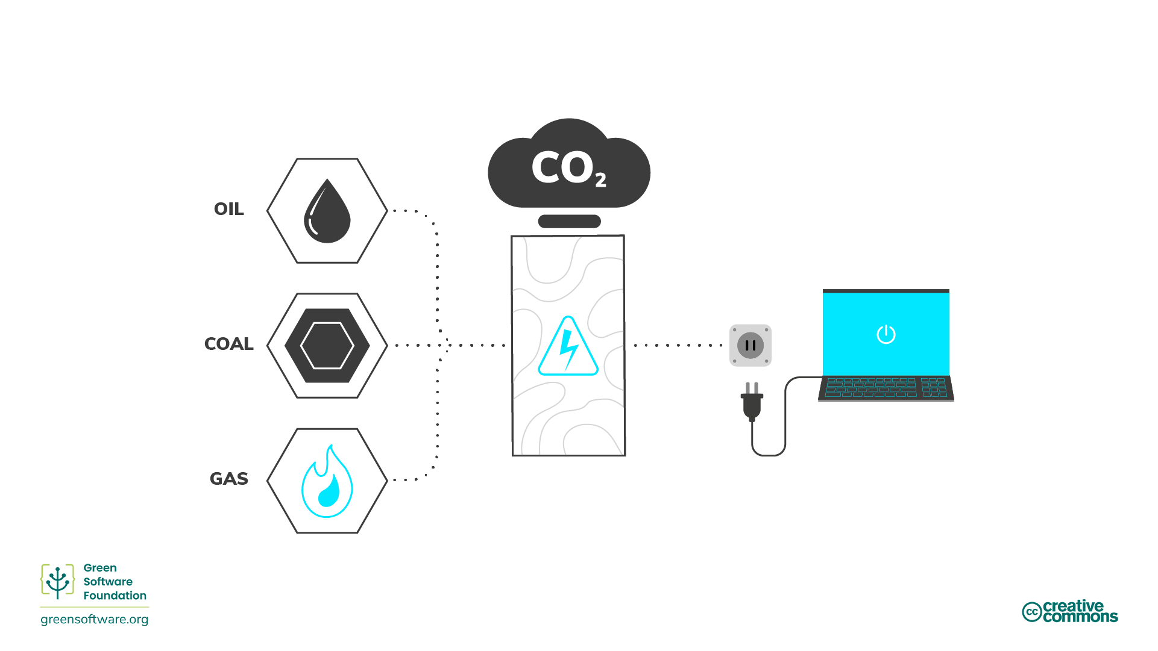

Slide 7
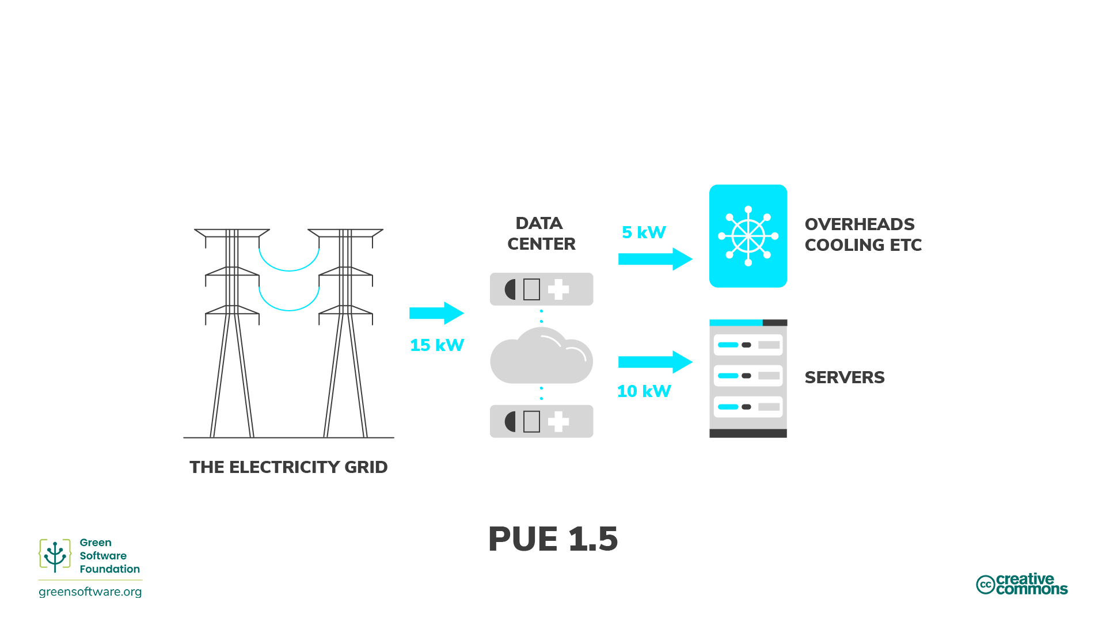

Slide 8
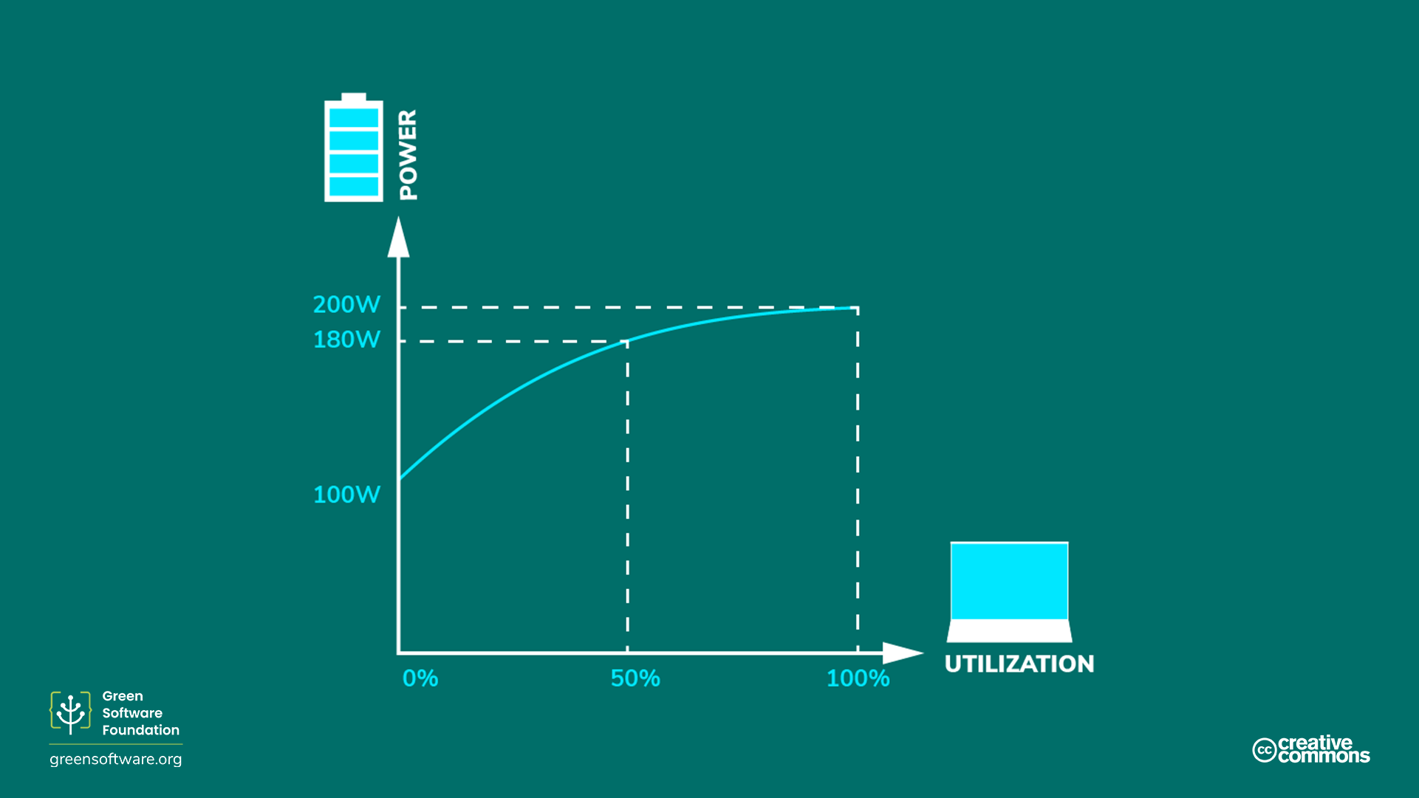

Slide 9

Which application consumes the most energy?
ⓘ Start presenting to display the poll results on this slide.

Slide 10
Hardware Efficiency

Slide 11
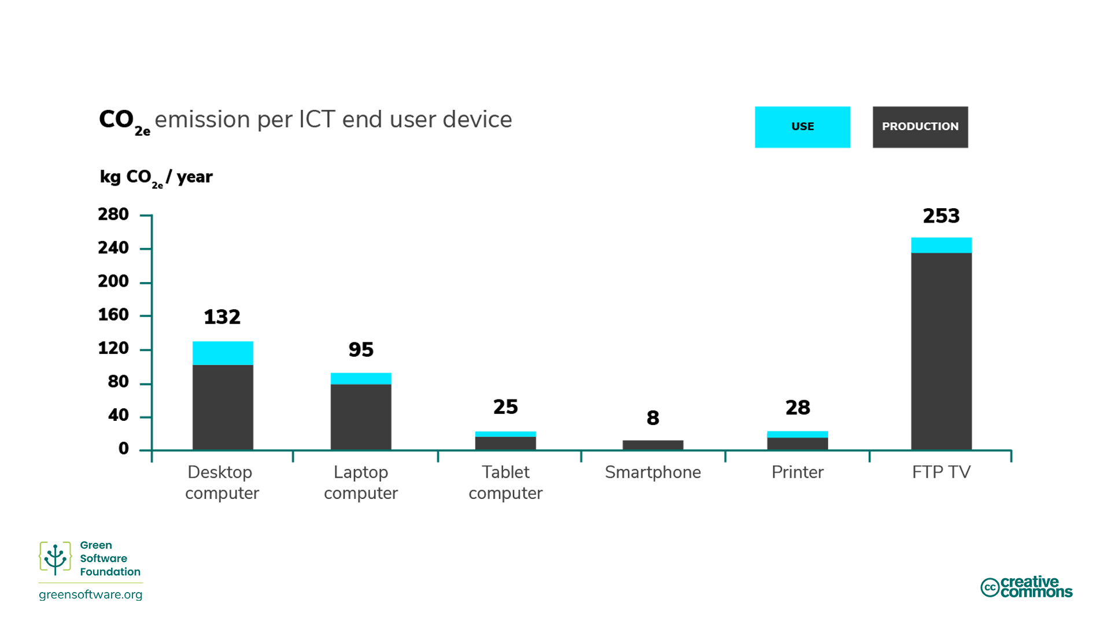

Slide 12
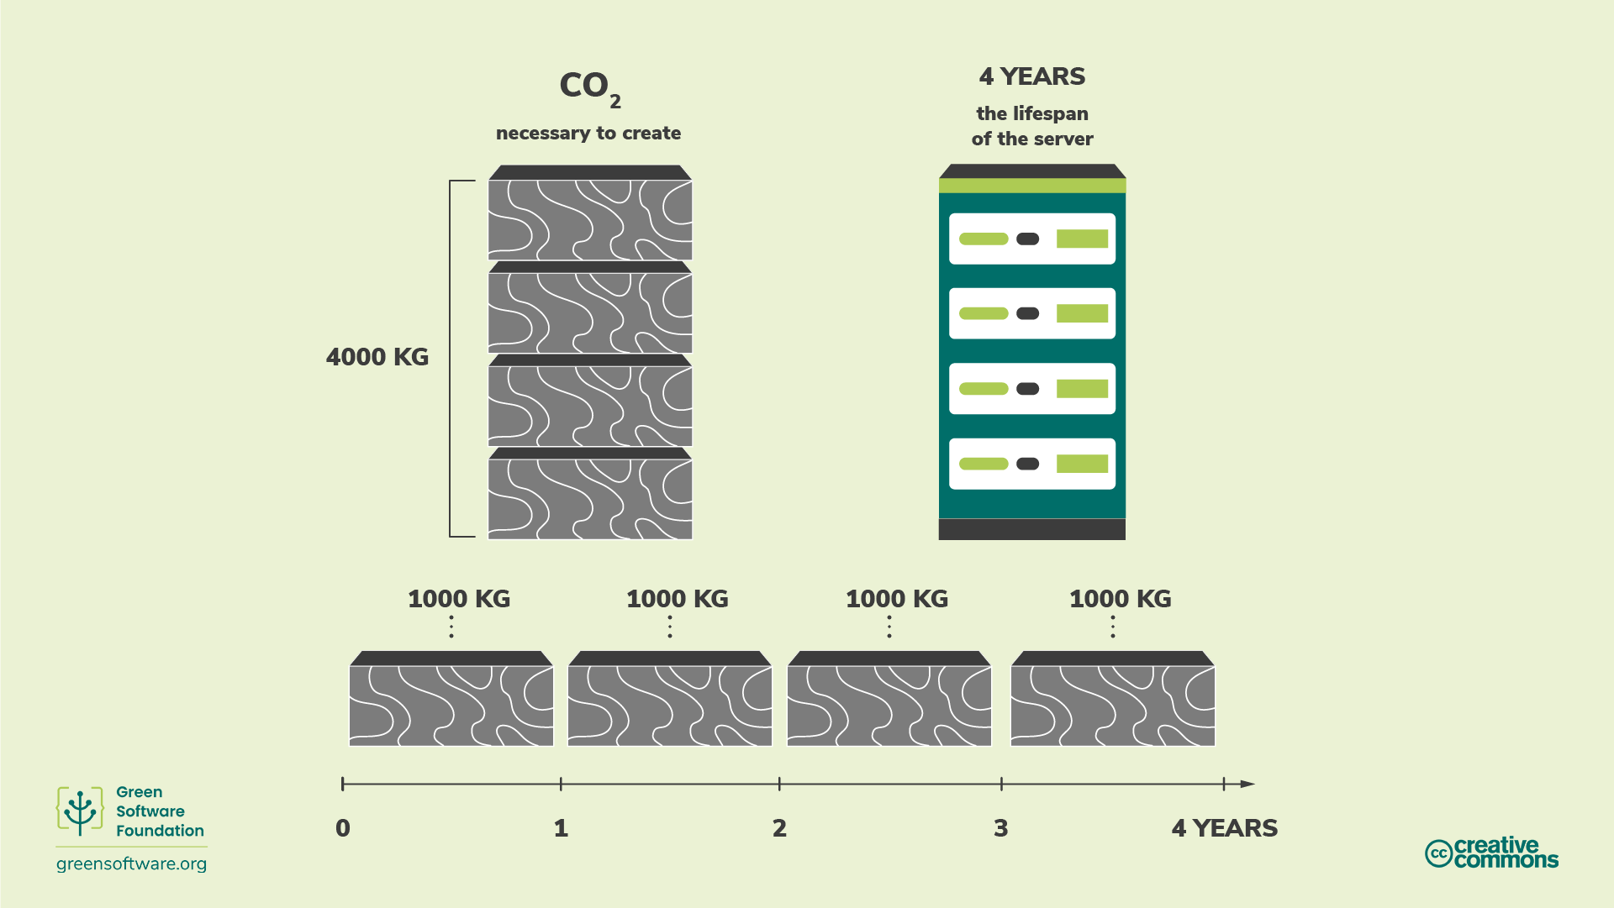

Slide 13
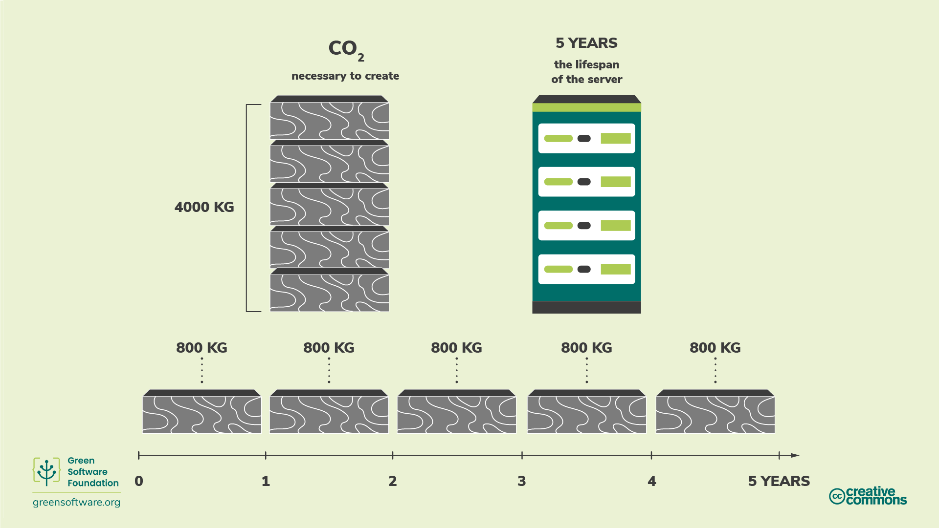

Slide 14
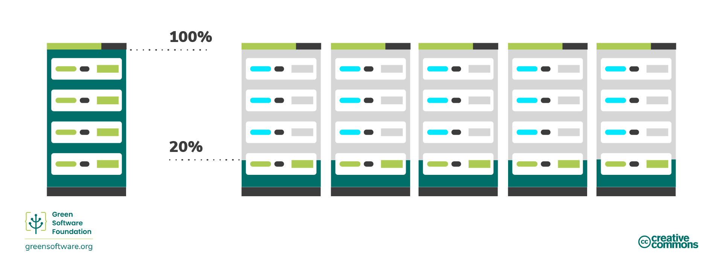
Increase device utilization

Slide 15
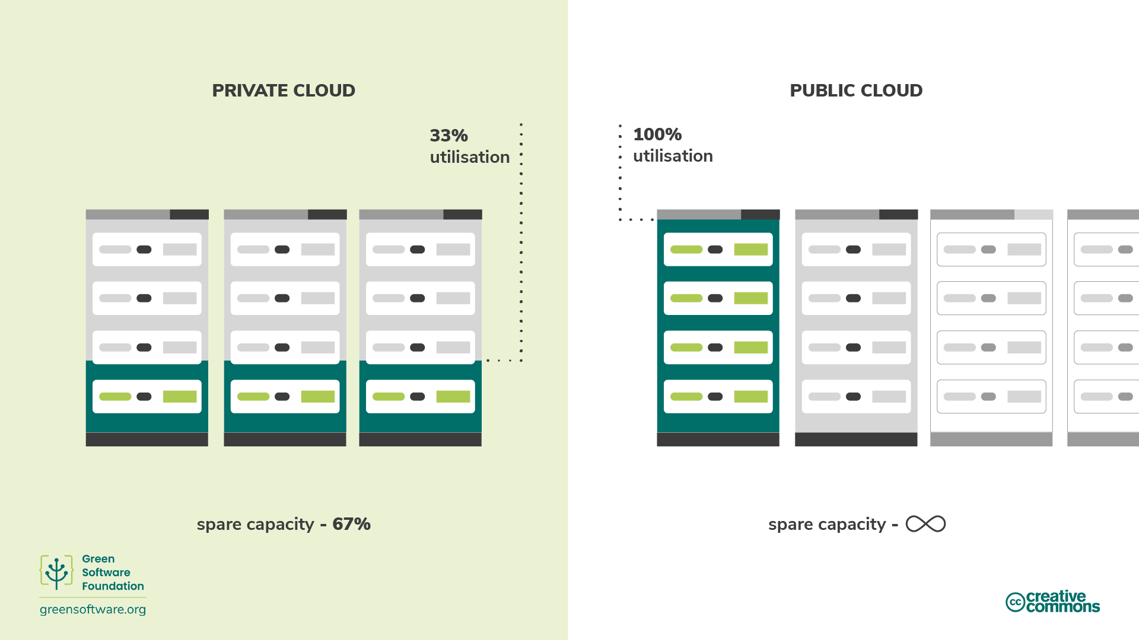

Slide 16
Why is it so important to include embodied carbon when calculating emissions for hardware?
ⓘ Start presenting to display the poll results on this slide.

Slide 17
Carbon Awareness

Slide 18
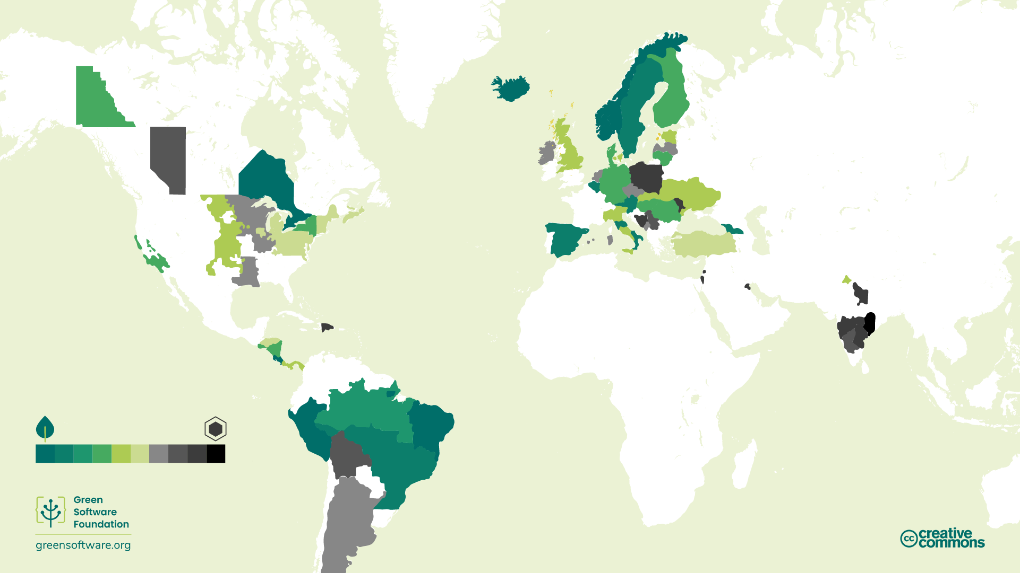

Slide 19
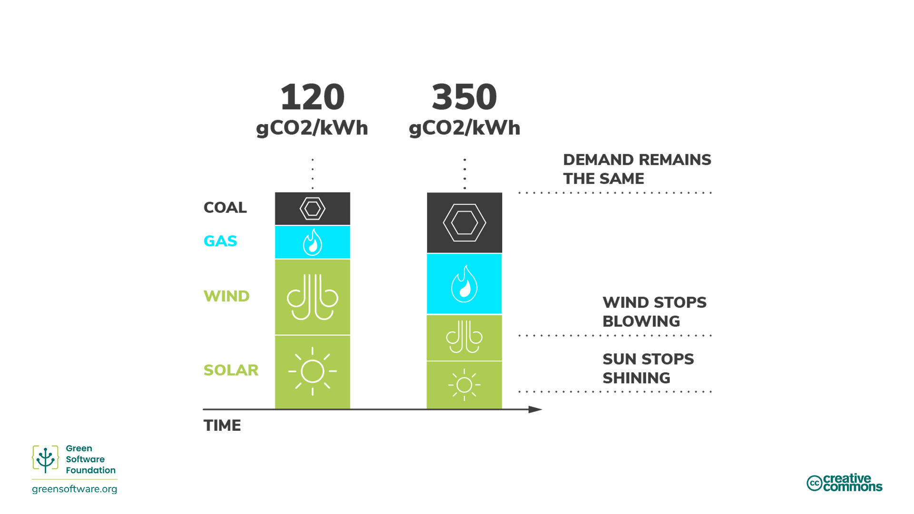

Slide 20
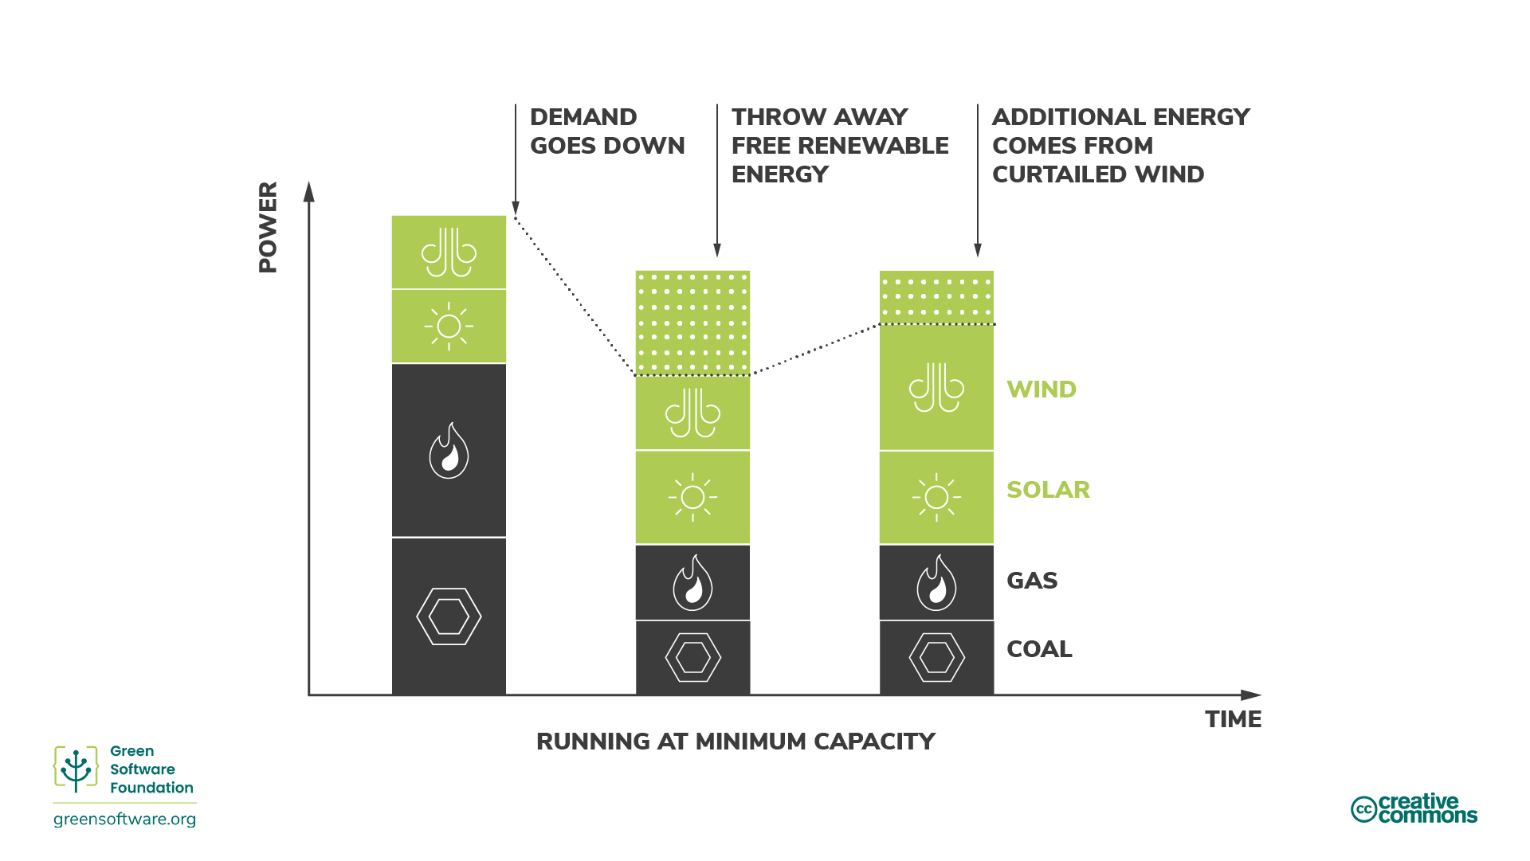

Slide 21
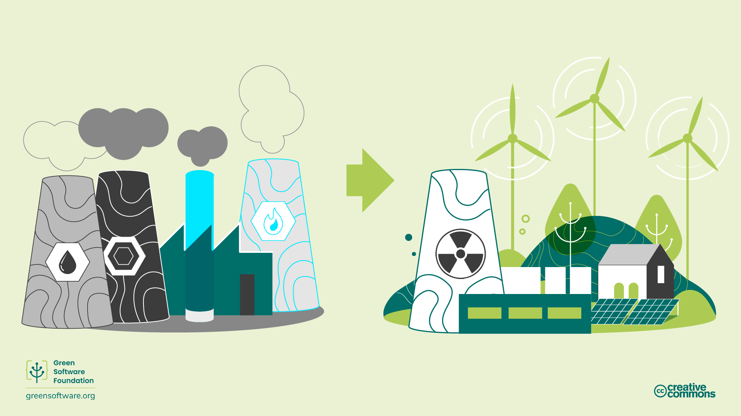

Slide 22
What two variables affect carbon intensity?
ⓘ Start presenting to display the poll results on this slide.

Slide 23
Shifting

Slide 24
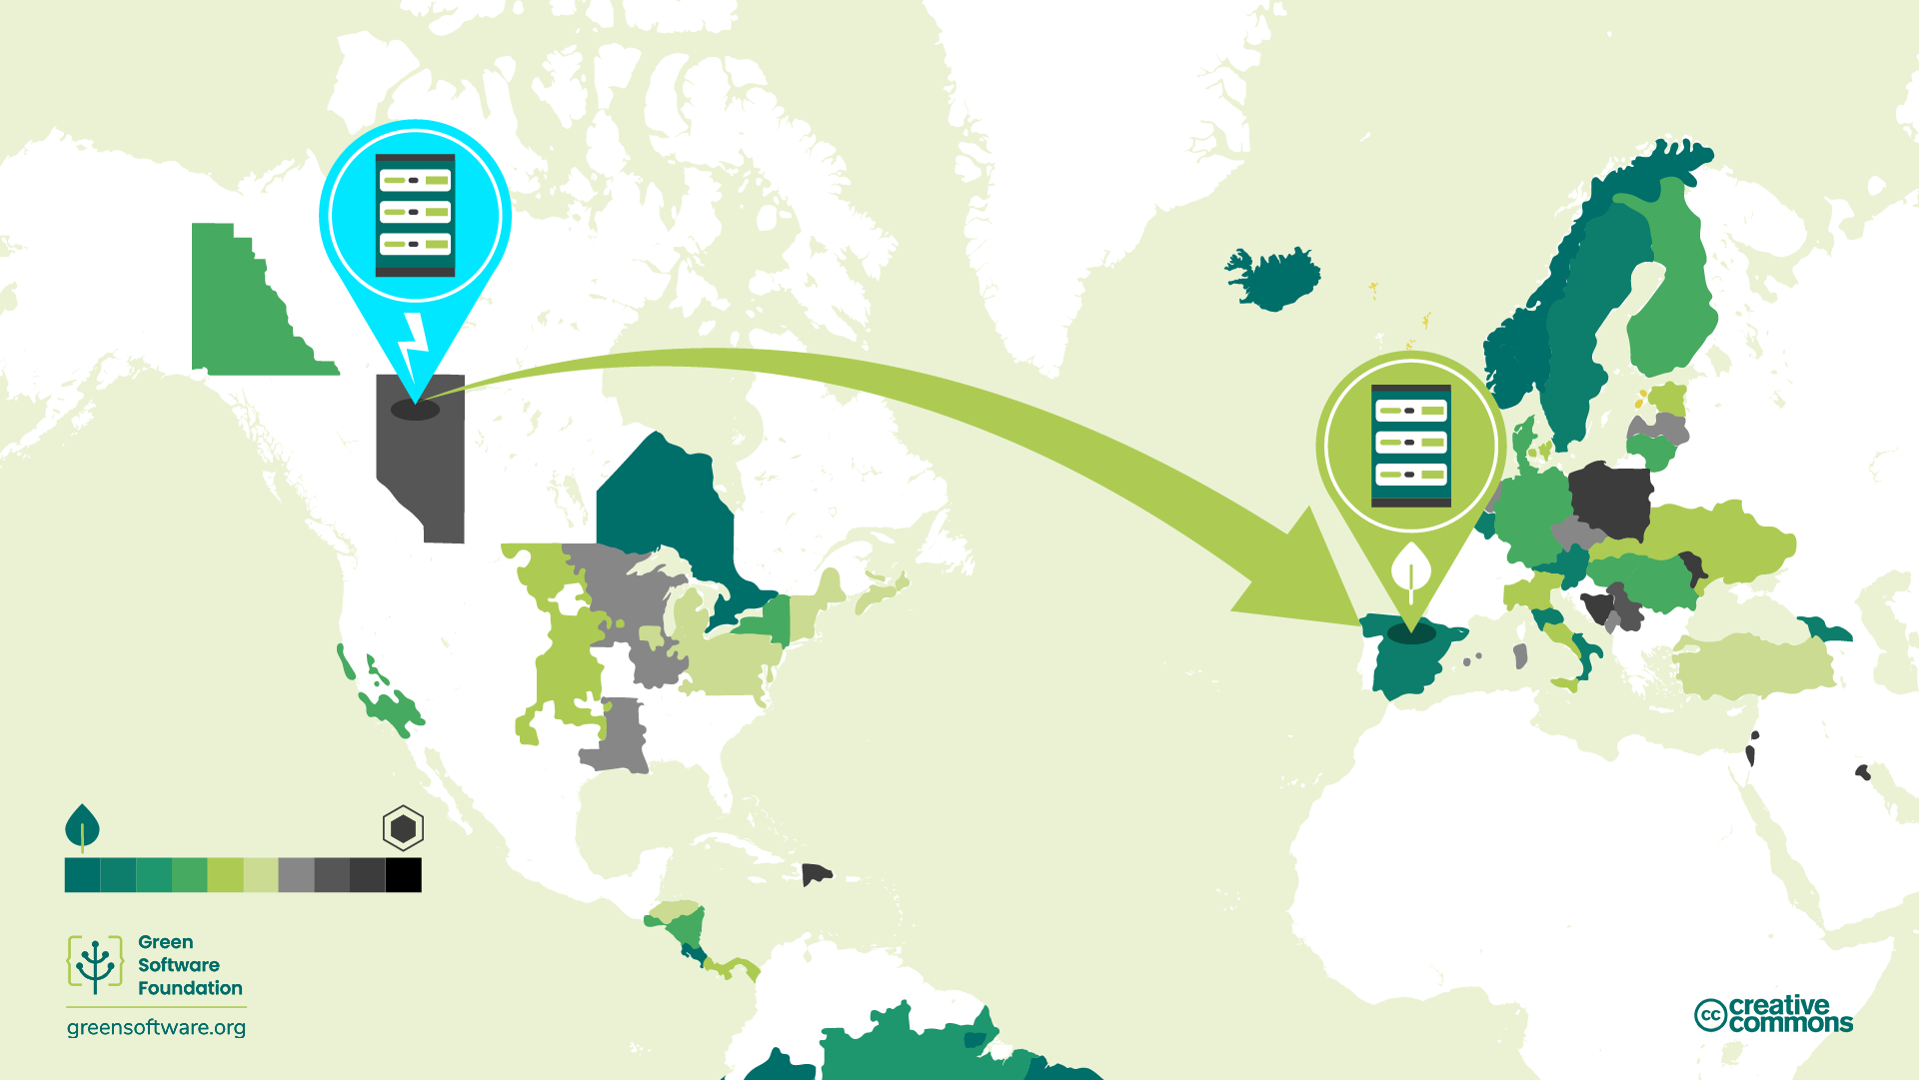

Slide 25
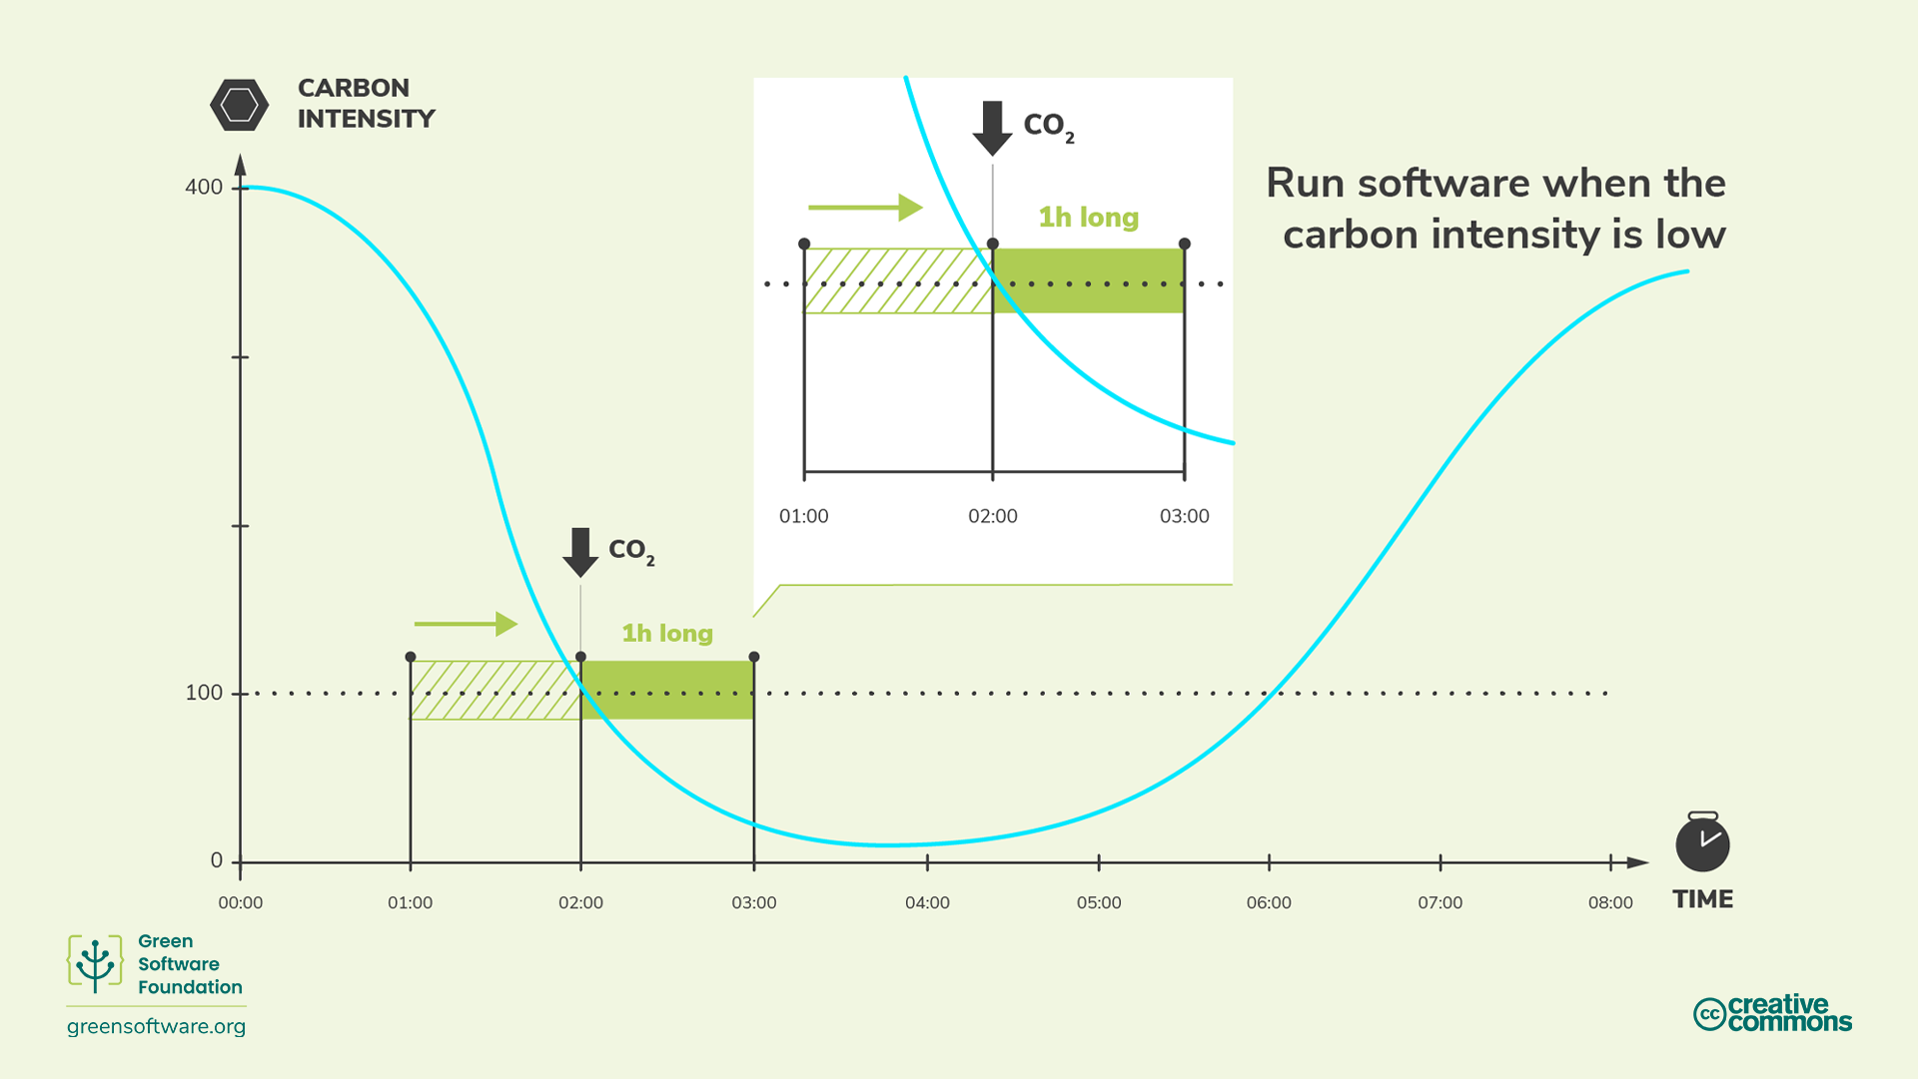

Slide 26
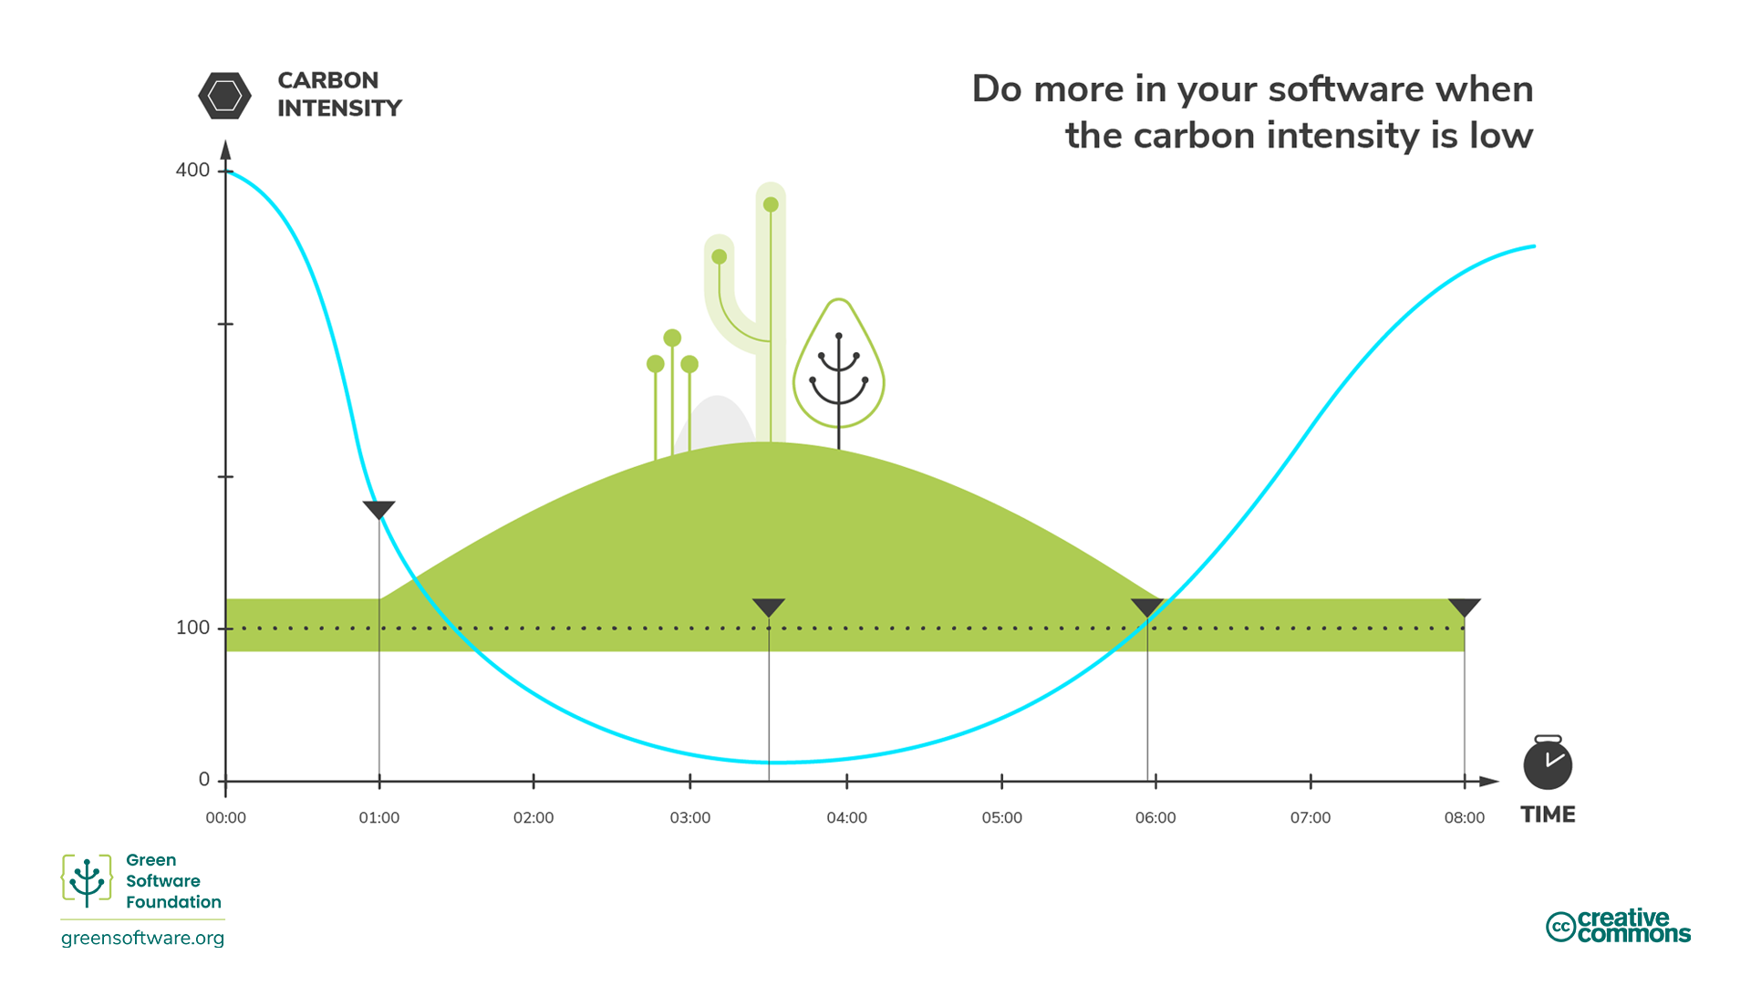

Slide 27
What are the two types of demand shifting?
ⓘ Start presenting to display the poll results on this slide.

Slide 28
Carbon Neutral vs Net Zero

Slide 29
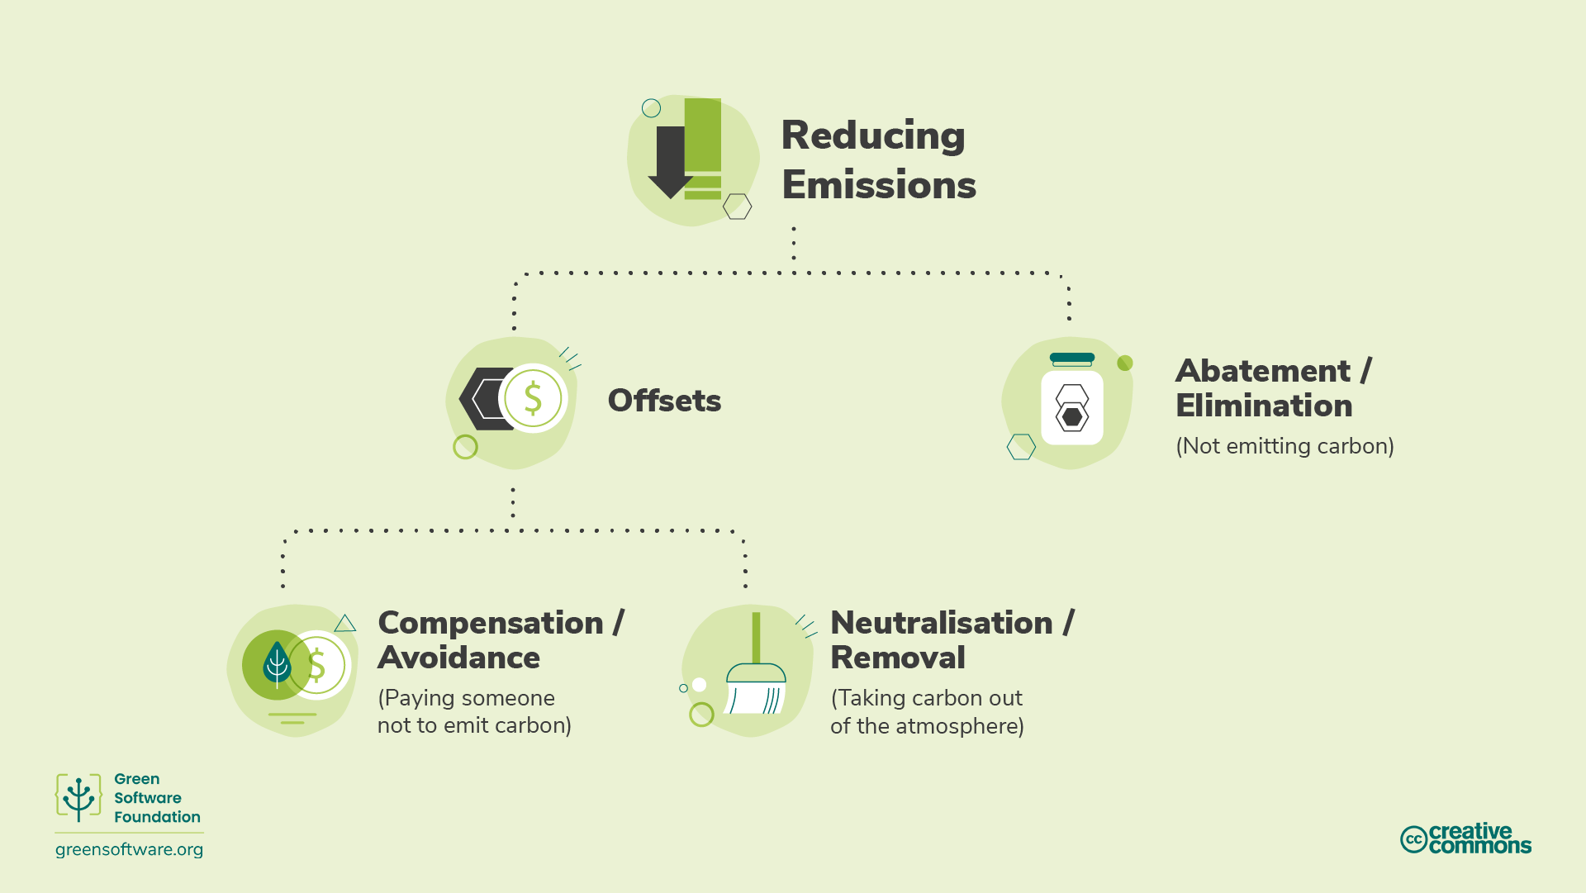

Slide 30
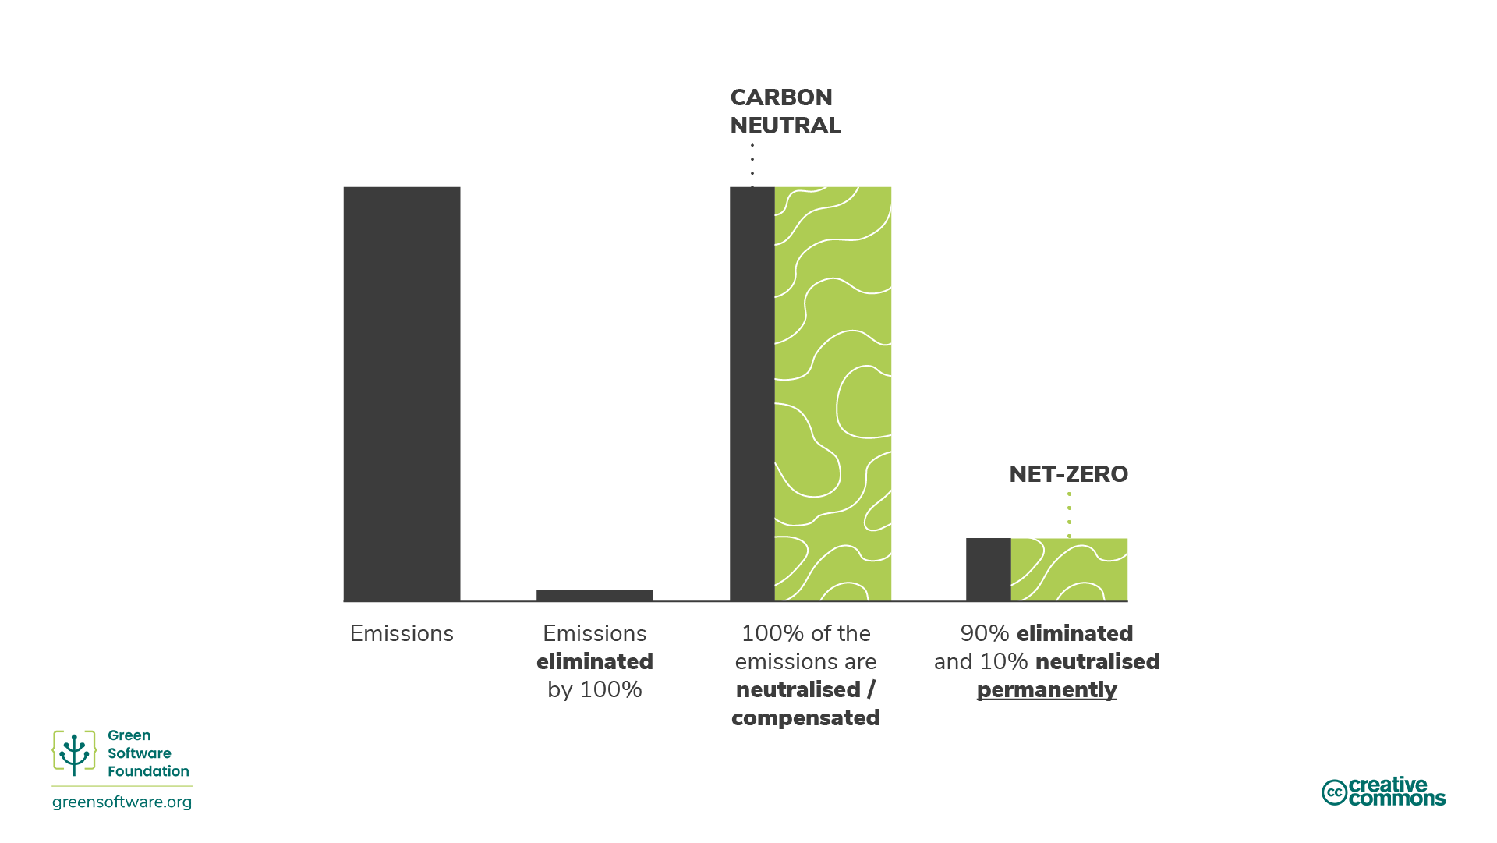

Slide 31
What is the primary goal with abatement/elimination?
ⓘ Start presenting to display the poll results on this slide.

Slide 32
Matching

Slide 33
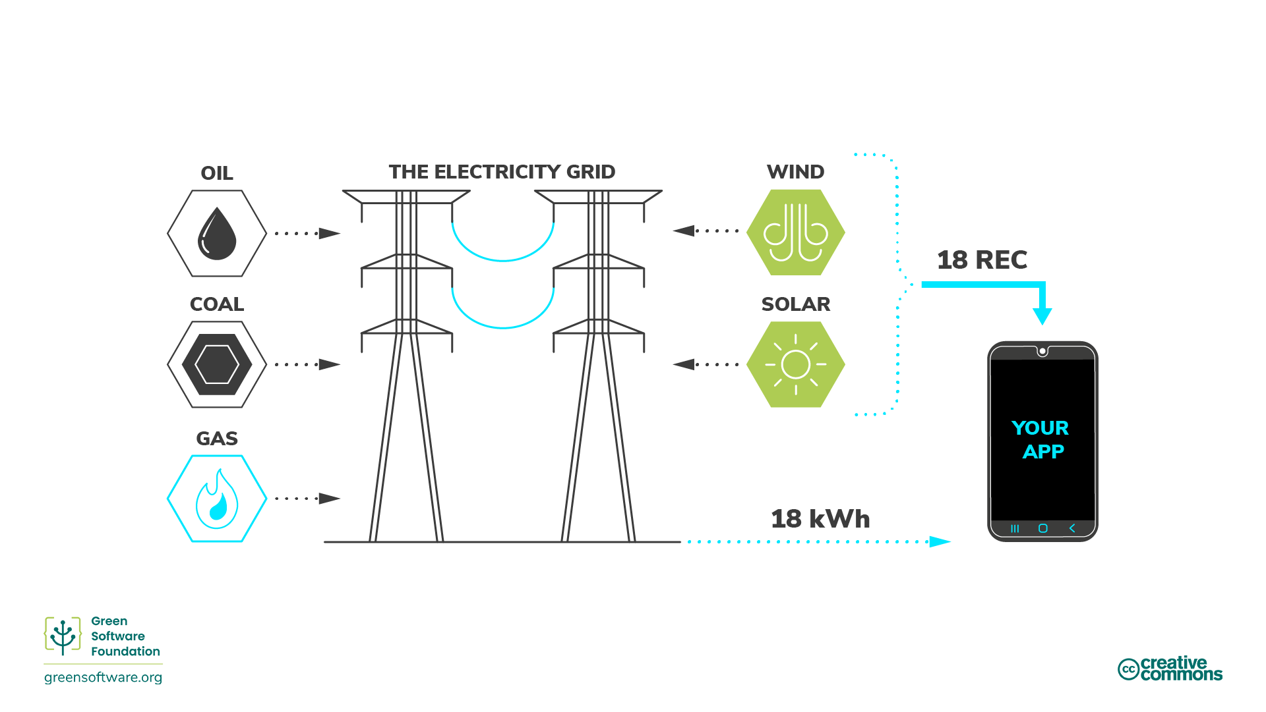

Slide 34


Slide 35
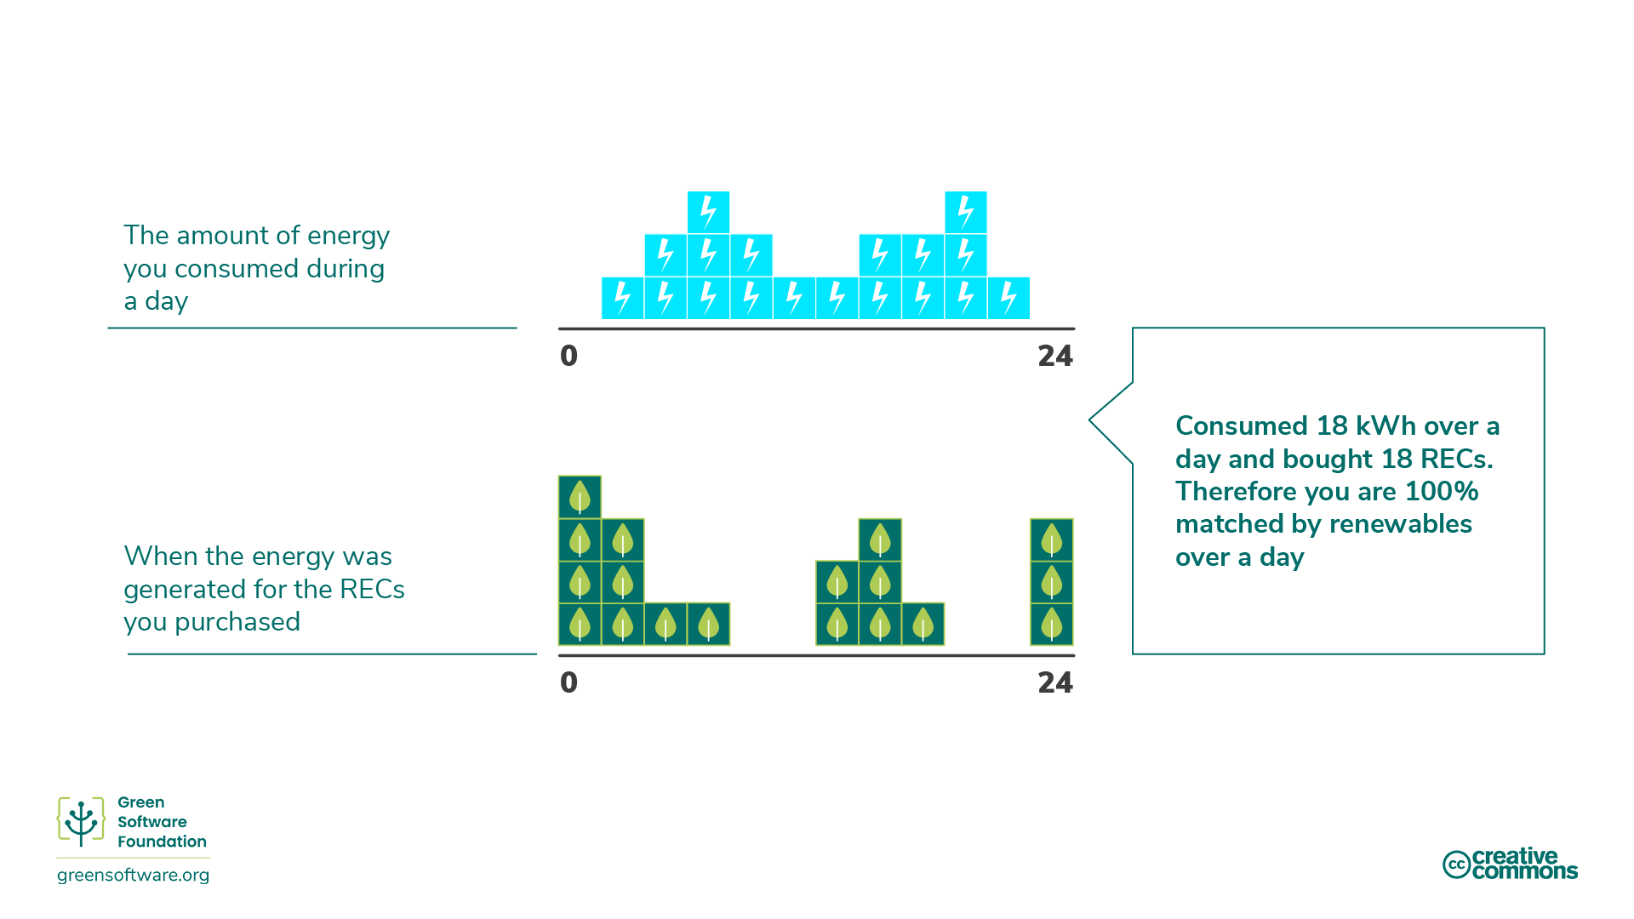

Slide 36
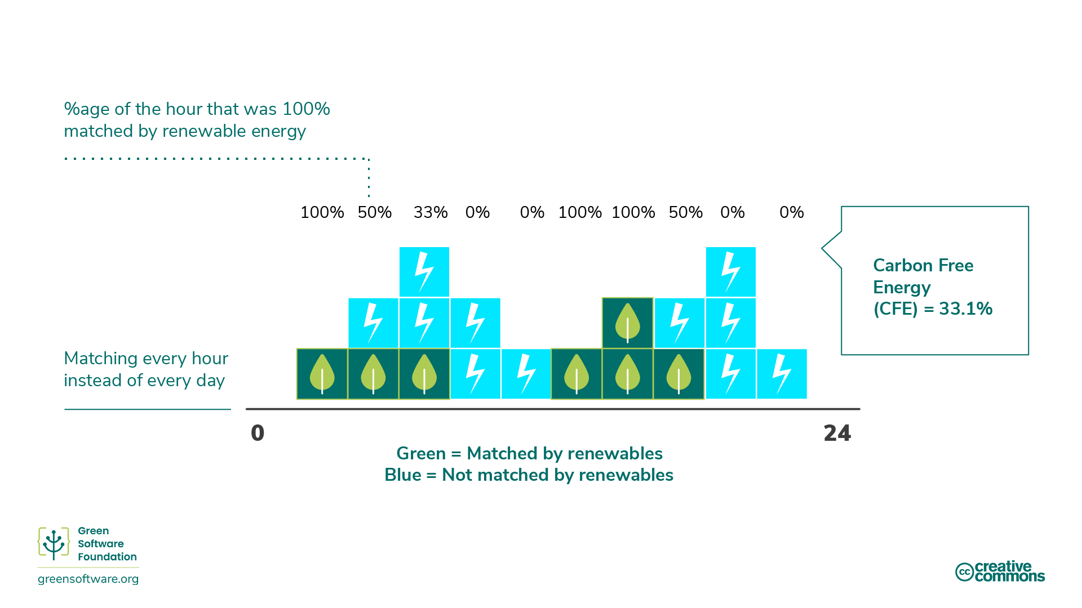

Slide 37
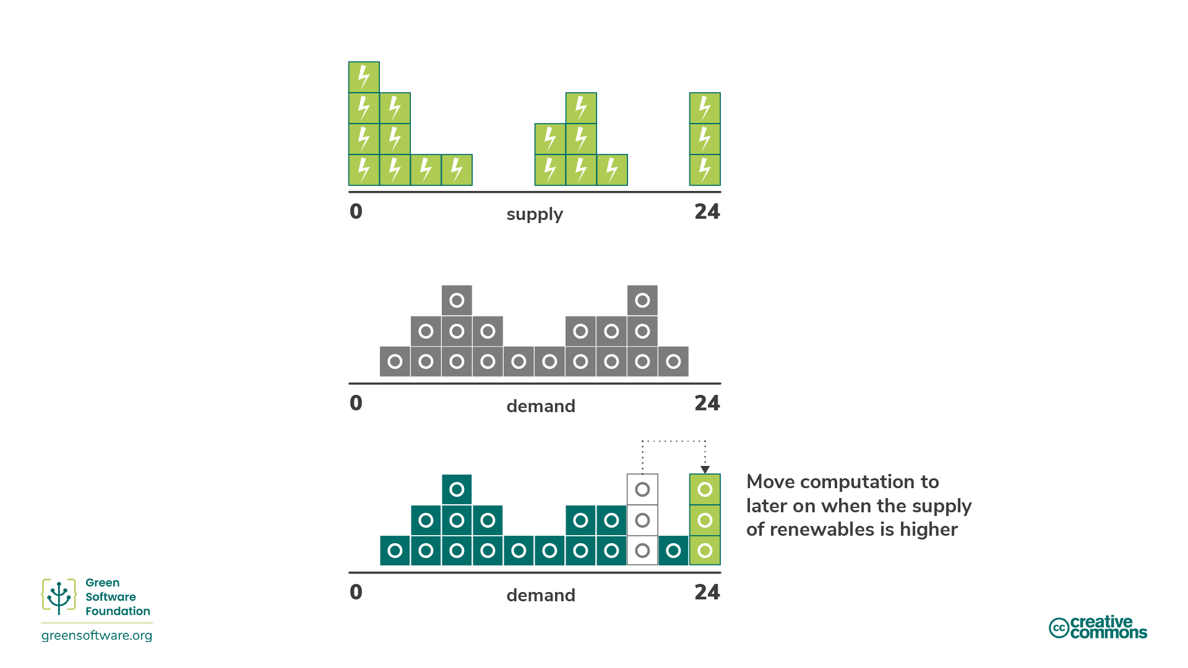

Slide 38
Measurment

Slide 39
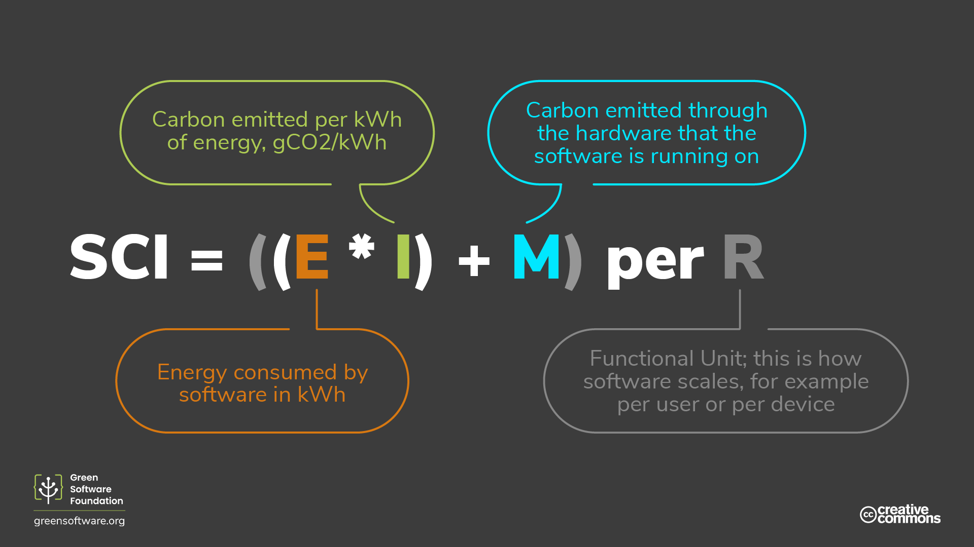

Slide 40
What does ((E*I) + M) represent in the SCI equation?
ⓘ Start presenting to display the poll results on this slide.

Slide 42
What’s Next

Slide 43

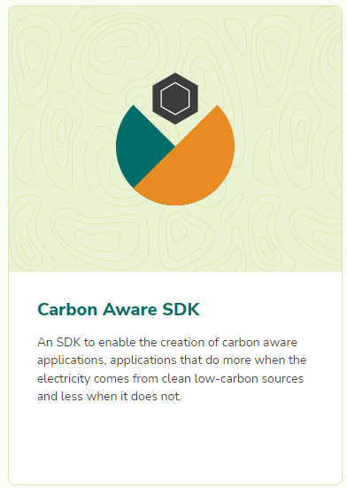


Slide 44

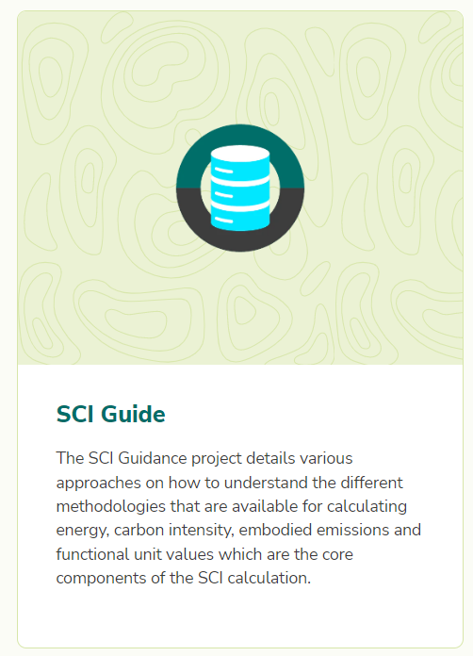
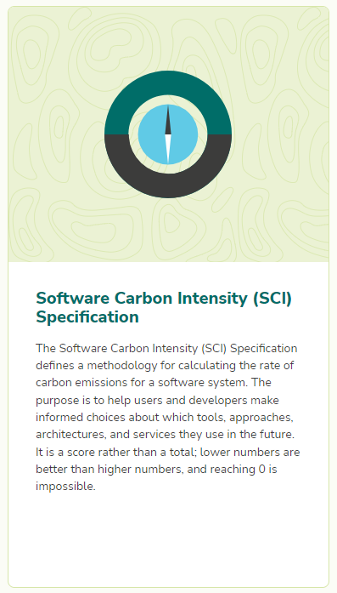

Slide 45
Green must be convenient
Roberto Freato Azure MVP / Author / CTO @Retex

